Slide 1
Title layout
subtitle

Slide 2
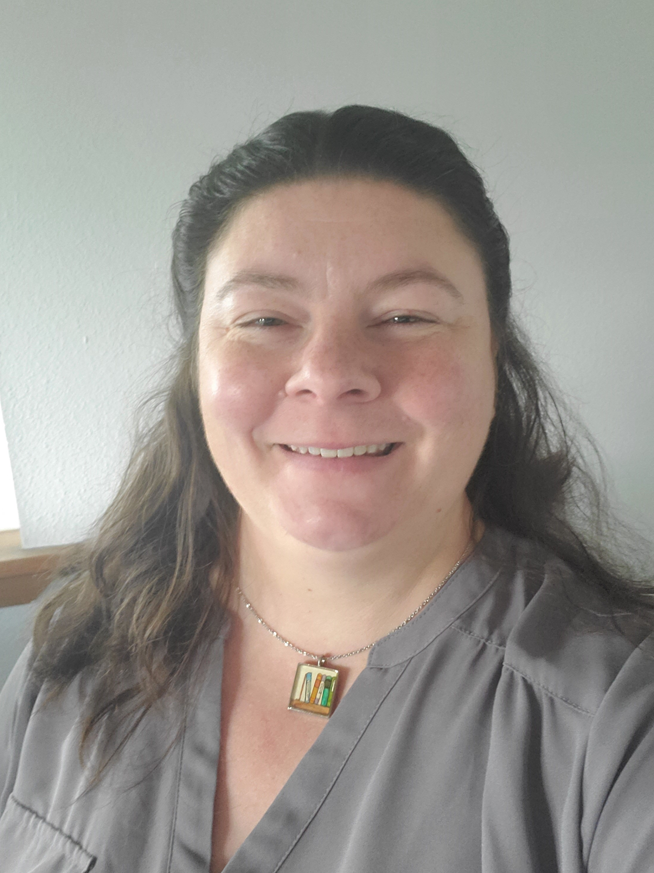
Brandie Hatch
Data Scientist Housing Hope
http://brandiehatch.com/
/in/brandiehatch/
Notes:
Presentation will be geared towards…

Slide 3
Agenda
Data Science Problem
Investigative Process (high level)
Primary Findings
Conclusions
Recommendations
Questions
Notes:
Consider the audience.
This presentation should be non-technical.
Start with the data science problem.
Use visuals that are appropriately scaled and interpretable.
Talk about your procedure/methodology (high level).
Talk about your primary findings.
Make sure you provide clear recommendations that follow logically from your analyses and narrative and answer your data science problem.

Slide 4


Introduction
With PowerPoint, you can create presentations and share your work with others, wherever they are. Type the text you want here to get started. You can also add images, art, and videos on this template. Save to OneDrive and access your presentations from your computer, tablet, or phone.
Notes:
Ames, Iowa diversity is within it’s Asian and Pacific Islander populations, but very limited in it’s Black and Native American populations. The city’s White population is 83% compared to….

Slide 5
Problem

Slide 6
Title and content layout with chart

Slide 7
Two content layout with table
First bullet point here
Second bullet point here
Third bullet point here
Class | Group 1 | Group 2
Class 1 | 82 | 95
Class 2 | 76 | 88
Class 3 | 84 | 90

Slide 8
Two content layout with SmartArt
First bullet point here
Second bullet point here
Third bullet point here
Group A
Group B
Group C
Group D

Slide 9
Add a Slide Title - 1

Slide 10
Add a Slide Title - 2
Sale Condition (Nominal): Condition of sale
Normal Normal Sale
Abnorml Abnormal Sale - trade, foreclosure, short sale
AdjLand Adjoining Land Purchase
Alloca Allocation - two linked properties with separate deeds, typically condo with a garage unit
Family Sale between family members
Partial Home was not completed when last assessed (associated with New Homes)

Slide 12
Add a Slide Title - 5

Slide 13

Thank You
Brandie Hatch
http://brandiehatch.com/
/in/brandiehatch/

Slide 14
Sources
Median Household Income Ames, IA: https://datausa.io/profile/geo/ames-ia#income_geo
2020 Census Demographic Data Map Viewer, Population Density, Race Alone or In Combination, Hispanic Origin, and Group Quarters: https://mtgis-portal.geo.census.gov/arcgis/apps/MapSeries/index.html?appid=2566121a73de463995ed2b2fd7ff6eb7
Past Housing Policies, Practices Contribute To Iowa's Racial Homeownership, Wealth Gaps | Iowa Public Radio | by Katarina Sostaric | https://www.iowapublicradio.org/racial-justice/2020-12-18/past-housing-policies-practices-contribute-to-iowas-racial-homeownership-wealth-gaps
Racial Disparities in Home Appreciation | Jul 15, 2019 | Michela Zonta | https://www.americanprogress.org/article/racial-disparities-home-appreciation/
Why the homeownership gap between White and Black Americans is larger today than it was over 50 years ago | https://www.cnbc.com/2020/08/21/why-the-homeownership-gap-between-white-and-black-americans-is-larger-today-than-it-was-over-50-years-ago.html
The American Dream While Black: "Locked in a Vicious Cycle" | https://www.nbcnews.com/specials/american-dream-while-black-homeownership/
Black Americans And The Racist Architecture Of Homeownership | NPR Code Switch | May 8, 2021 11:20 AM ET | By Ailsa Chang, Christopher Intagliata, Jonaki Mehta | https://www.npr.org/sections/codeswitch/2021/05/08/991535564/black-americans-and-the-racist-architecture-of-homeownership
Research: More oil and gas wells in redlined neighborhoods Historically marginalized communities are exposed to more wells with their accompanying pollution | By Dylan Svoboda | April 13, 2022 | https://publichealth.berkeley.edu/news-media/research-highlights/research-more-oil-and-gas-wells-in-redlined-neighborhoods/
City of Ames: https://www.cityofames.org/
Neighborhoods of Ames, IA from Prediction Model of Ames Real Estate Prices: https://rstudio-pubs-static.s3.amazonaws.com/337439_24918eaefe724411be93e41ede48b256.html

